Slide 1


Master of Applied Data Science: Portfolio Milestone
Marley Akonnor
SU ID: 662128458
Summer 2022

Slide 2

Selected Coursework:
IST 659 - Database Administration Concepts & Database Management – Capital Custom Clothiers
IST 652 – Scripting for Data Analysis – LA & New York, A Decade of Crime
IST 718 – Big Data Analytics - InsurTex

Slide 3
Program Objectives:
Describe a broad overview of the major practice areas in data science
Collect and organize data
Identify patterns in data via visualization, statistical analysis, and data mining
Develop alternative strategies based on the data
Develop a plan of action to implement the business decisions derived from the analyses
Demonstrate communication skills regarding data and its analysis for managers, IT professionals, programmers, statisticians, and other relevant professionals in their organization
Synthesize the ethical dimensions of data science practice (e.g., privacy).

Slide 4

IST 659: Database Administration Concepts & Database Management
Deliverable:
The deliverable for this course consisted of two parts ultimately meant to culminate in the design and implementation of a database with the ability to solve a data management issue

Slide 5
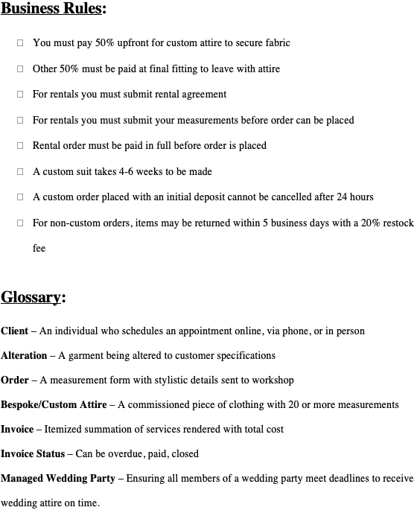
Consult with Stakeholders:
Data Collection
Establish Business Rules
Establish Business Vernacular
Mockaroo used for ethical reasons

Slide 6

Business Questions:
What is the most purchased piece of custom attire?
How many weddings are done annually?
What types of alterations are done the most?
How many made to measure shirts are done annually?

Slide 7
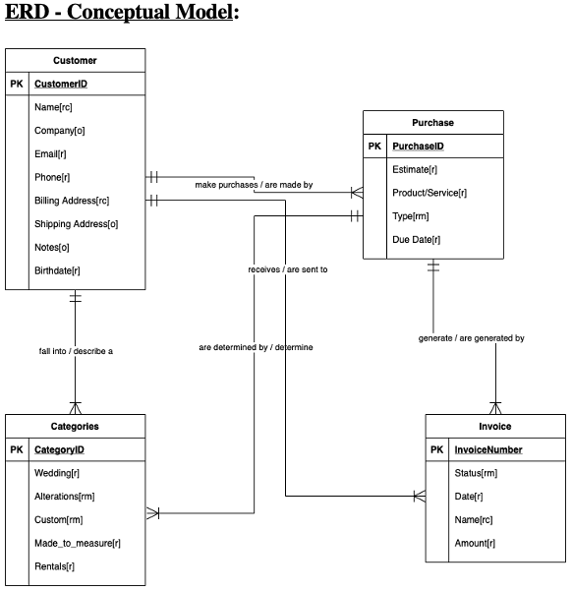
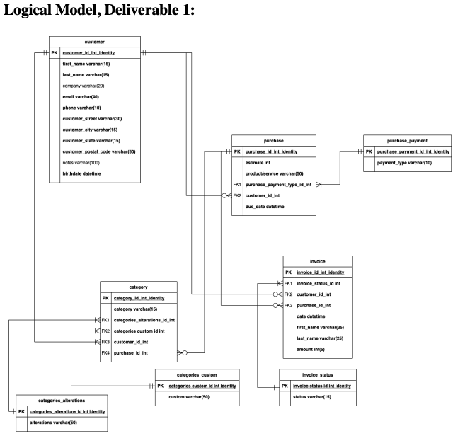
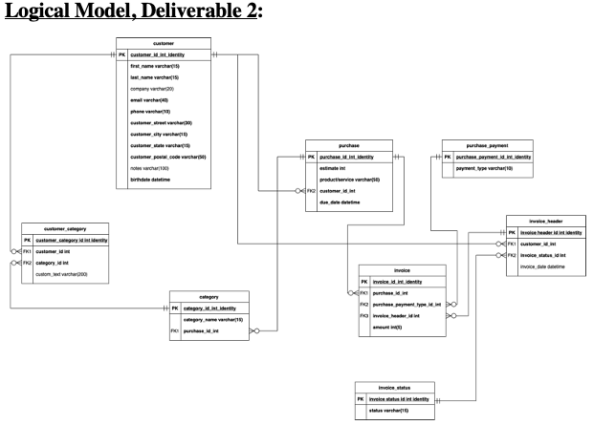
Conceptual Model to Fully Normalized:
Notes:
In the final stage of the logical model, the redundant relationships were decomposed and removed leaving only normalized relation between the primary keys and foreign keys of each table

Slide 8
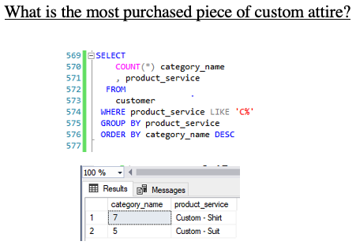
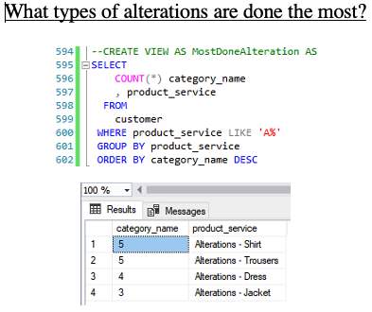
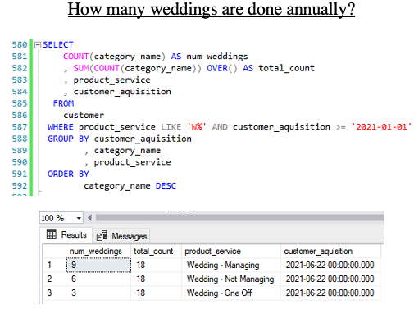
Final Product:
Fully normalized and function database
Views were created for the most commonly run queries for ease of use
Abstract away need to SQL skillet with a GUI
Notes:
The last phase of this project consisted of converting the final logical model into a physical database using SQL in SQL Server Management studio. As a test of efficacy, the database needed to be capable of answering specific data business questions. An acknowledgement, for ethical reasons, mock data was used to protect the personally identifiable information of Capital Customer Clothier clients such as home address, credit card information, phone number, etc.

Slide 9

IST 652: Scripting for Data Analysis
Deliverable:
The deliverable, “LA & NYC, A Decade of Crime Comparison”, executed on the outlined objectives by conducting a crime analysis of New York and Los Angeles from disparate data sets and included a sentiment analysis from Twitter using API calls:

Slide 10

Data Collection:
Data Sources:
Kaggle
LA Crime Data and NYC Crime Data
Twitter API
Notes:
The selected data sets from Kaggle, LA Crime Data and NYC Crime Data, provide longitudinal examinations of crime trends over a decade. A greater perspective can be gleaned regarding the types of crimes committed, the amount of crime committed, and what time periods crime was most prevalent between two major cities on opposite coasts. The intention, a comparative analysis demonstrating either a parallel or inverse relationship with crime patters. These two cities are amongst the largest and most densely populated urban areas in America which make them more prone to visible shifts in crime and the ideal candidates for examination
The data cleaning was executed by importing the individual CSV files into the notebook. The first data set, LA Crime Data, had 2,118,203 rows and 28 columns.
The second data set, NYC Crime Stats, underwent a similar revision. Initially, the data set began with 3,881,989 rows and 19 columns
Since a decade is the time horizon being examined, all data prior to the year 2009 was removed. The final data frame for analysis consisted of 2,637,776 rows and 3 columns excluding the index.

Slide 11
Research Questions:
Question 1: When was crime most prevalent in both cities?
Question 2: What were the top 10 most common crimes across both cities?
Question 3: When did crime in LA peak?
Question 4: What was the most common crime in LA in 2014?
Question 5: Crime, specifically burglary, was at its highest in 2017. What was the conversation on Twitter like during 2017 in LA regarding burglary?

Slide 12
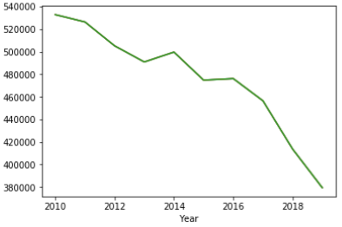
Question 1: When was crime most prevalent in both cities?
Crime was most prevalent in 2010 for both cities
The largest count of crimes committed were classified as “Dangerous Drugs” at 507,493.
This makes sense intuitively as the US has undergone various magnitudes of opioid epidemics

Slide 13
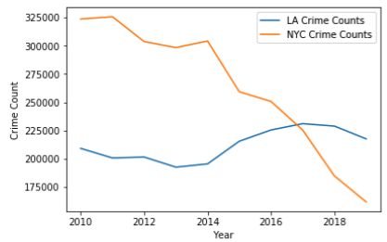
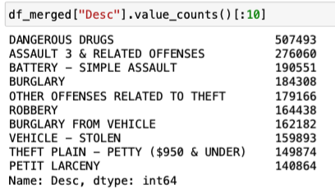
Question 2: What were the top 10 most common crimes across both cities?
When the data was separated, it revealed that the initial line plot was heavily influenced by NYC’s crime trends.
LA in that decade had considerably less crime until around 2017 when the overall crime volume in LA exceeded that of NYC handedly

Slide 14
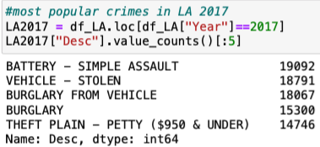
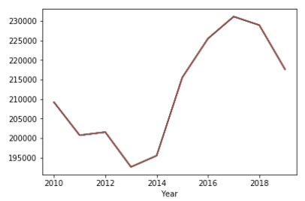
Question 3: When did crime in LA peak?
It is apparent that crime jumped drastically from 2013-2017.
In 2013 there were less than 195,000 crimes and that number rose alarmingly to 230,000 in 2017.
Trump?

Slide 15
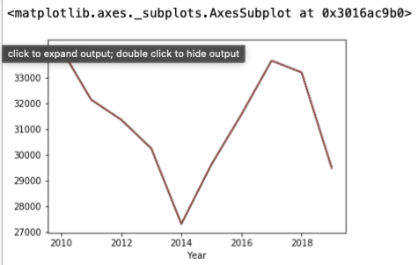
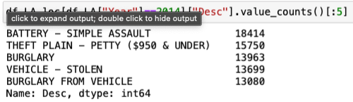
Question 4: What was the most common crime in LA in 2014?
2014 was one of the lowest crime points in the decade for crime in LA.
This piqued an inquiry into if the low may have also influenced a shift in the ordinal placement of the most common crimes over the decade.
Even in 2014, the order and crimes remained consistent with “Battery – Simple Assault” still at the top

Slide 16
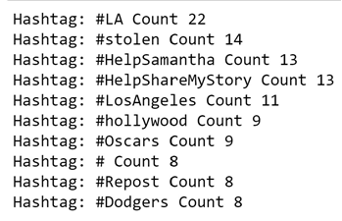
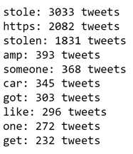
Question 5: Crime, specifically burglary, was at its highest in 2017. What was the conversation on Twitter like during 2017 in LA regarding burglary?

Slide 17

IST 718: Big Data Analytics
Deliverable:
The deliverable, a comprehensive business report that addressed the inquiry of internal stakeholders regarding the appropriate insurance premiums over the next 5 years for the company

Slide 18

Data Sources:
2020 Insurance Council of Texas Property & Casualty Insurance Market Report
Assessment of Historic and Future Trends of Extreme Weather In Texas, 1900-2036
Corporate and Insurance Data 2008-2021
Monthly and Annual Totals – Precipitation Data for Texas
El Paso Data + totals
Amarillo Totals
Dallas
Houston
Brownsville
Laredo
FEMA National Risk Index
El Paso
Amarillo
Dallas
Houston
Austin
Brownsville
Laredo
State Insurance Regulation: Key Facts and Market Trends
Insurance Information Institute
Direct Premiums Written
Domestic Insurance Companies
Property Casualty Insurance
Energy Star – Texas Weather

Slide 19
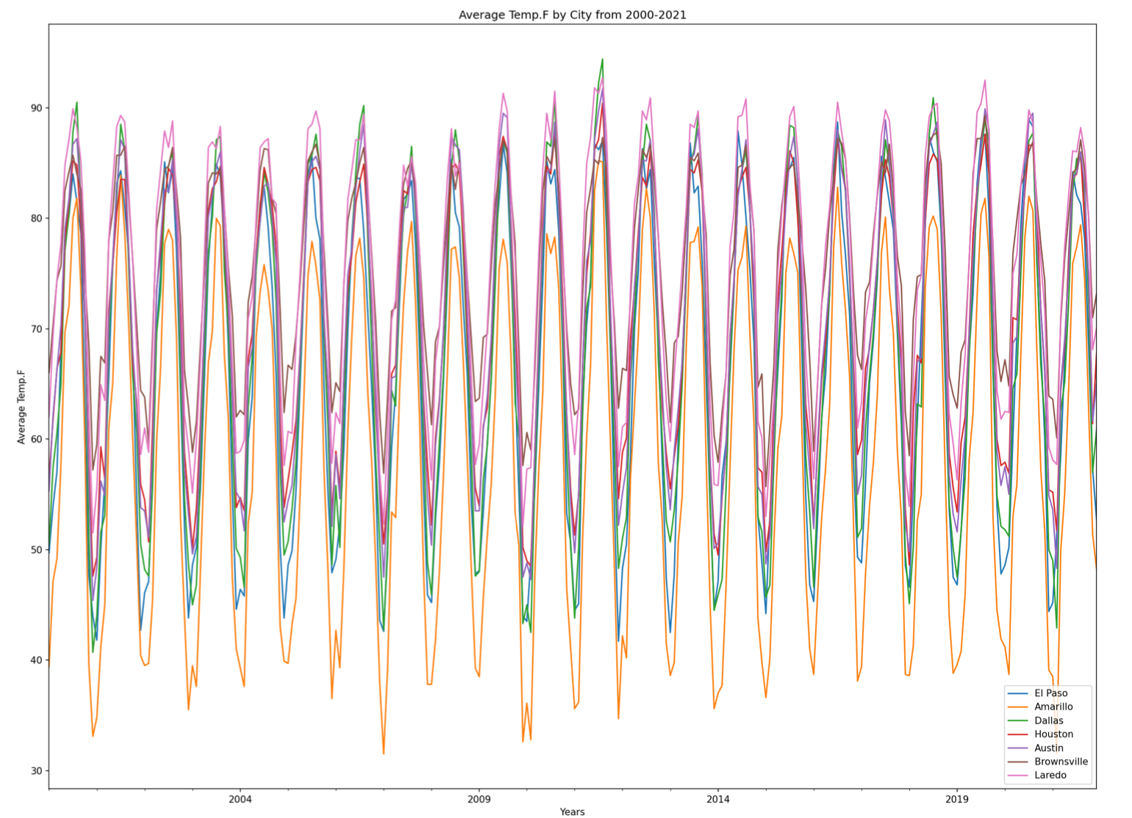
Observation:
The plot displays average temperature by city from the year 2000 to 2021.
Though Dallas had the highest average temperature over the 21-year time horizon with a spike to ~92 degrees in 2012, Loredo has consistently been the hottest of the 7 cities.
Conversely, Amarillo has consistently had the lowest average temperatures without competition dropping to temperatures as frigid as ~30 degrees in 2007 and achieving it once again in 2021.

Slide 20
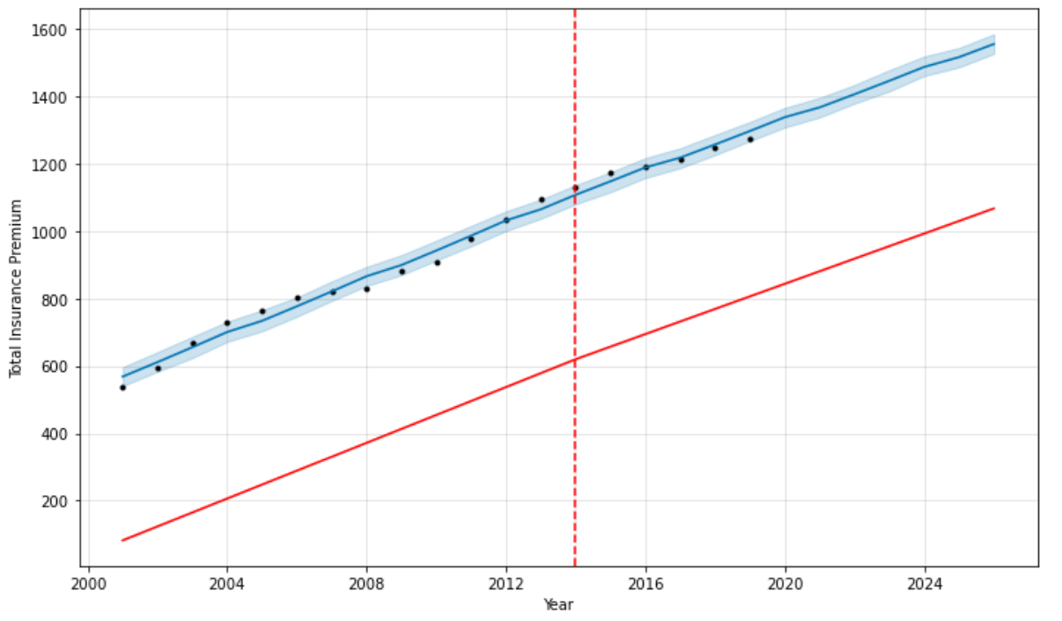
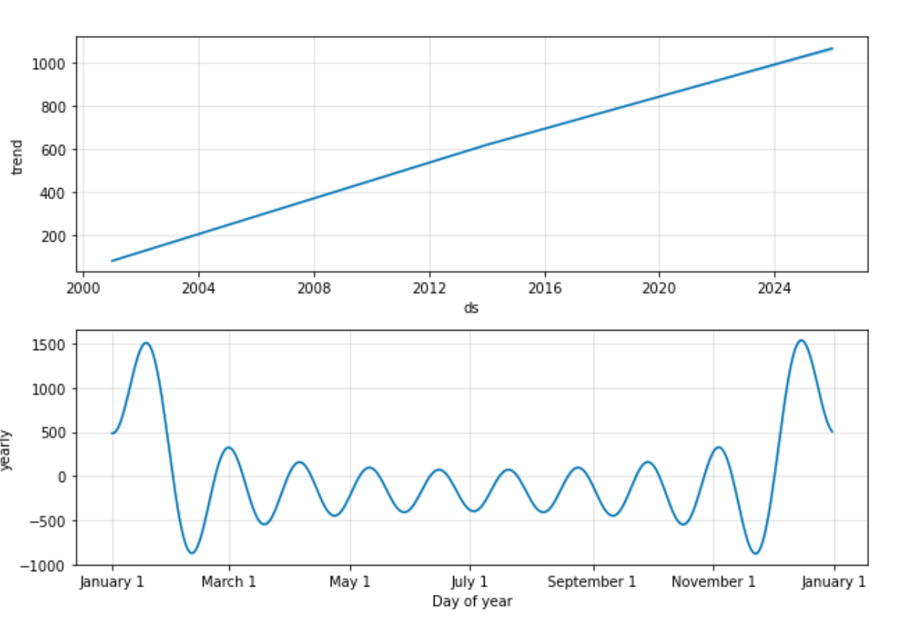
Insurance Projections:

Slide 21
Insurtex Recommendations:
Fiscal Year | Premium Price
2022-2023 | $1,406.10
2023-2024 | $1,446.09
2024-2025 | $1,487.14
2025-2026 | $1,516.30
2026-2027 | $1,555.24
These projections were selected with the use of the Prophet algorithm
Insurance premiums are projected to rise for the next 5 fiscal years.

Slide 22

References:
Akonnor, M. (n.d.). MSDS-Portfolio/CapitalCustomClothiers_Database_Project.pdf at main · Makonnor1/MSDS-Portfolio. GitHub. Retrieved August 2, 2022, from https://github.com/Makonnor1/MSDS-Portfolio/blob/main/CapitalCustomClothiers_Database_Project.pdf
Akonnor, M. (n.d.-b). MSDS-Portfolio/InsurTex - Final Project.pdf at main · Makonnor1/MSDS-Portfolio. GitHub. Retrieved August 2, 2022, from https://github.com/Makonnor1/MSDS-Portfolio/blob/main/InsurTex%20-%20Final%20Project.pdf
Akonnor, M. (n.d.-c). MSDS-Portfolio/LA & NYC - A DECADE OF CRIME COMPARISON.pdf at main · Makonnor1/MSDS-Portfolio. GitHub. Retrieved August 2, 2022, from https://github.com/Makonnor1/MSDS-Portfolio/blob/main/LA%20%26%20NYC%20-%20A%20DECADE%20OF%20CRIME%20COMPARISON.pdf

Slide 23
Conclusion:
The contents of this portfolio are meant to be indicative of mastery regarding the four pillars of the Applied Data Science program and well as the 7 program objectives. It was a privilege to be taught by stellar educators who have a passion for the discipline. While Data Science is a degree, it is more importantly, a skillset that I will always carry with me from this day forward. You have my gratitude.
Best,
Marley Akonnor, MSDS

Slide 24

Thanks for everything. It’s been a pleasure.

